Slide 1
SELENIUM WEBDRIVER PROJECT FOR GLOBALSQA WEBSITE.
By-Rajashree Chitale
Guided By-Amruta Deore
Batch Number-5532

Slide 2
AGENDA
Lounching The Browser .
To Verify The Title Of The Website.
To Verify Scrolling Functionalty.
To The Test The Different Webelement in Tester’s Hub Module.

Slide 3
INTRODUCTION
This Website Is For Cheat Sheets, Mind Maps, Free Ebooks.
In This Project Our Main Focus Is To Test The Tester’s Hub Module.
In This Website We Also Test the Home Page Of Site
In Tester’s Hub, The Different Web Element Are Available For Testing Purpose.

Slide 4
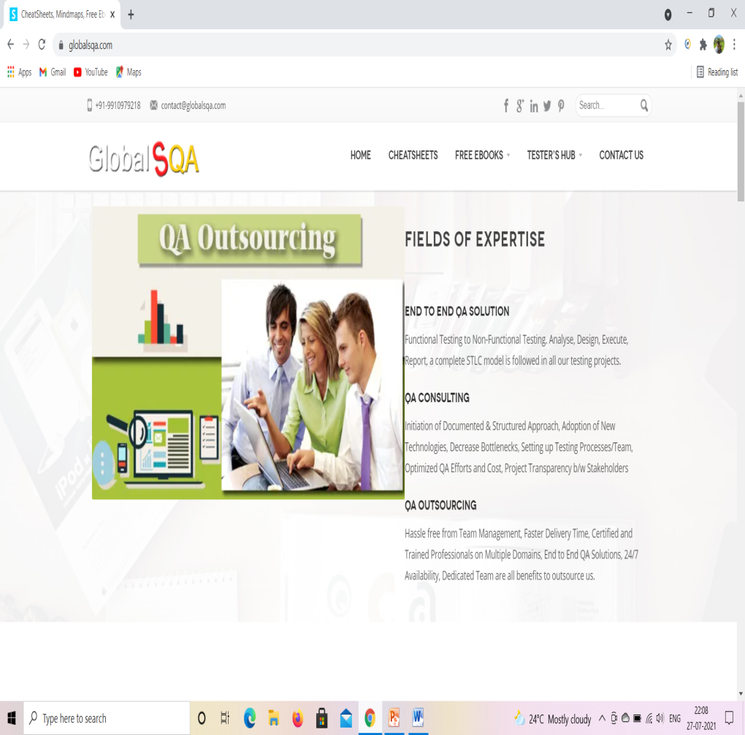
TC01: Launch the browser and Globalsqa website
Selenium WebDriver Test Script:
WebDriver d = new ChromeDriver();
d.manage().window().maximize();
driver.manage().deleteAllCookies();
driver.manage().window().maximize();
driver.manage().timeouts().implicitlyWait(30, TimeUnit.SECONDS);
driver.manage().timeouts().pageLoadTimeout(40, TimeUnit.SECONDS);
driver.get("https://www.globalsqa.com/");

Slide 5
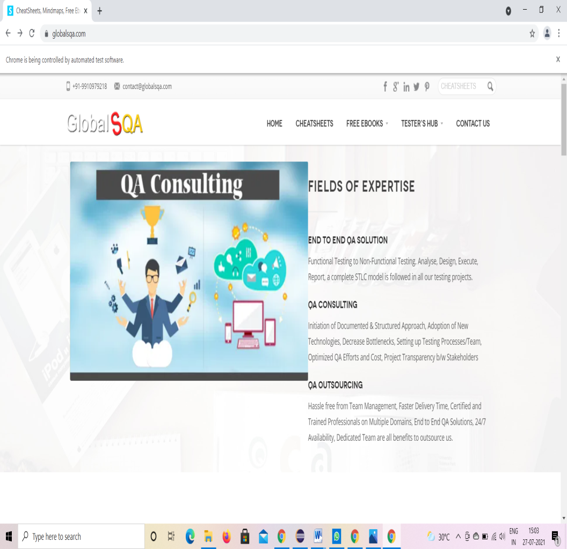
TC02: To verify the functionality of Globalsqa
d.findElement(By.xpath("//body/cclink[1]/main[1]/div[2]/section[1]/div[2]/a[1]/div[1]")).click();

Slide 6
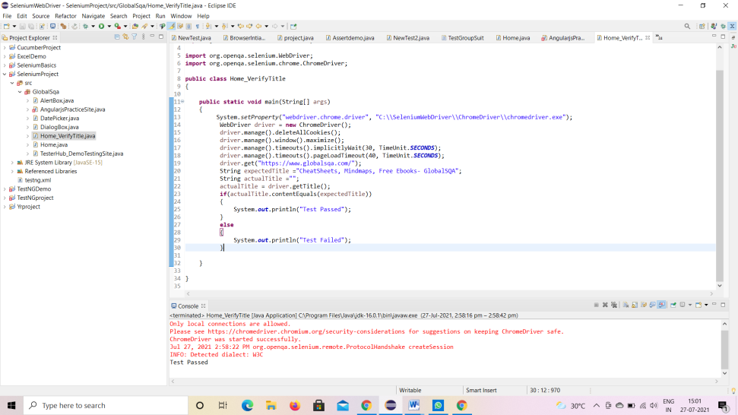
TC03: To verify Title and Display Passed On Console.
Selenium WebDriver Test Script:
String expectedTitle ="CheatSheets, Mindmaps, Free Ebooks- GlobalSQA";
String actualTitle ="";
actualTitle = driver.getTitle();
if(actualTitle.contentEquals(expectedTitle))
{ System.out.println("Test Passed");
}
else
{
System.out.println("Test Failed");
}

Slide 7
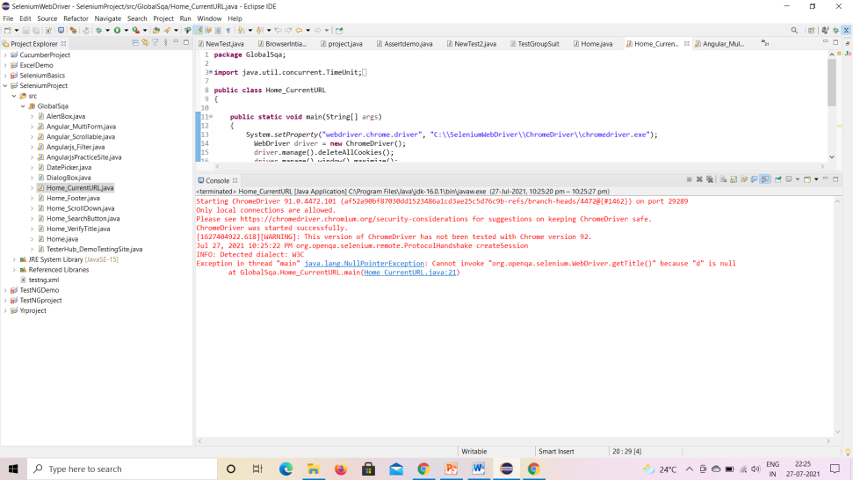
TC04: To verify and display the Title of the current page.
Selenium WebDriver Test Script:
d.getTitle();
System.out.println("Title of page is:" + d.getTitle());

Slide 8
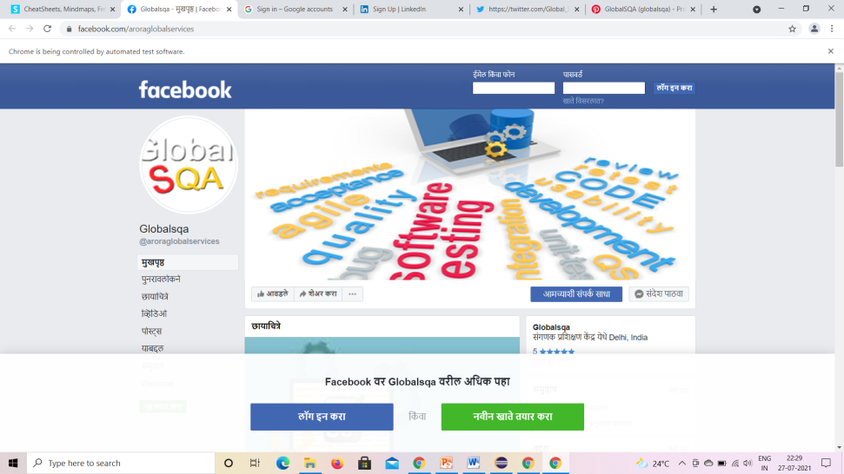
TC05: To verify the Footer Of Home Page.
Selenium WebDriver Test Script:
driver.findElement(By.className("header_soc_facebook")).click();
driver.findElement(By.className("header_soc_google")).click();
driver. findElement(By.className("header_soc_linkedin")).click();
driver. findElement(By.className("header_soc_twitter")).click();
driver. findElement(By.className("header_soc_pinterest")).click();

Slide 9
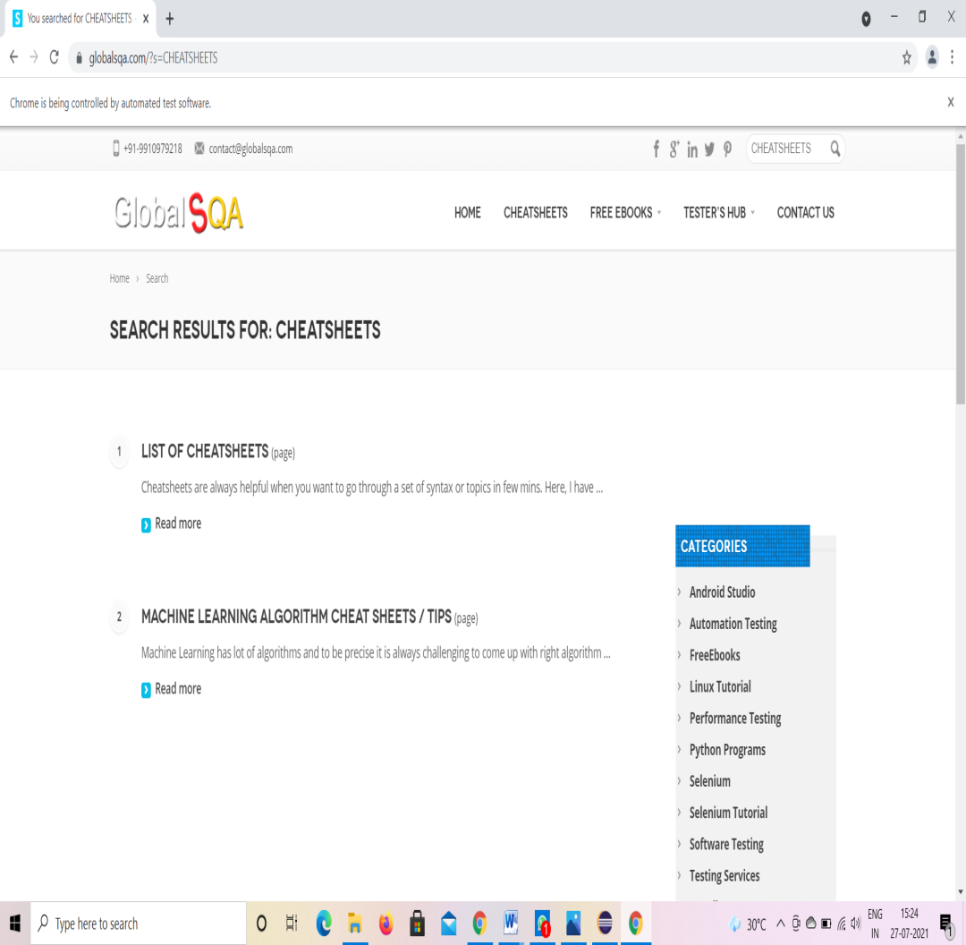
TC06: To verify the functionality of Search Button.
Selenium WebDriver Test Script:
driver.findElement(By.id("s")).sendKeys("CHEATSHEETS");
driver.findElement(By.className("button_search")).click();
try
{
Thread.sleep(2000);
}
catch (InterruptedException e)
{
e.printStackTrace();
}

Slide 10
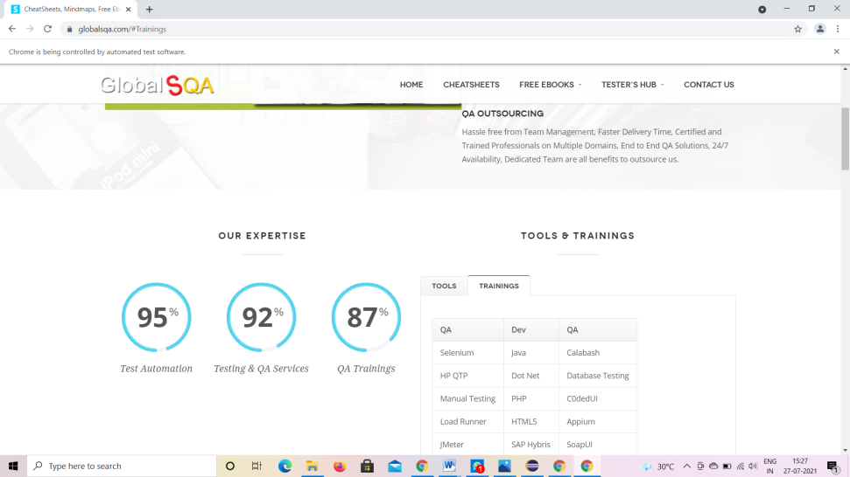
TC07: To verify the functionality of Scroll Bar And Select Training And Tool Options.
Selenium WebDriver Test Script:
((JavascriptExecutor)driver).executeScript("scroll(0,400)");
driver.findElement(By.id("Tools")).click();
try
{
Thread.sleep(2000);
}
catch (InterruptedException e)
{
e.printStackTrace();
}

Slide 11
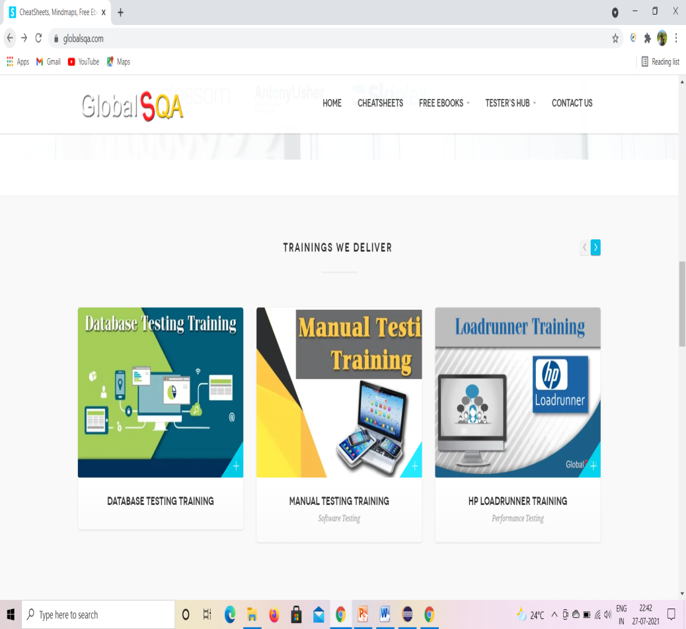
TC08: To verify the functionality Of Scroll Bar And Select Training.
Selenium WebDriver Test Script:
((JavascriptExecutor)driver).executeScript("scroll(0,1300)");
driver.findElement(By.className("jcarousel-next jcarousel-next-horizontal")).click();

Slide 12
To verify the Mouse Over Functionality And Select Demo Testing Site.
Selenium WebDriver Test Script:
WebElement TesterHub = driver.findElement(By.xpath("//*[@id=\"menu-item-2822\"]/a")); //mouse over on testerhub
Actions builder = new Actions(driver);
builder.moveToElement(TesterHub).build().perform();
WebElement DemoTesting = driver.findElement(By.xpath("/html/body/div/header/div[2]/div/div/div[3]/div/ul/li[4]/div/ul/li[1]/a/span")); //mouse over on demo testing site
Actions builder1 = new Actions(driver);
builder1.moveToElement(DemoTesting).build().perform();
driver.findElement(By.xpath("/html/body/div/header/div[2]/div/div/div[3]/div/ul/li[4]/div/ul/li[1]/div/ul/li[1]/a/span")).click();
driver.findElement(By.id("Forms Based")).click();

Slide 13
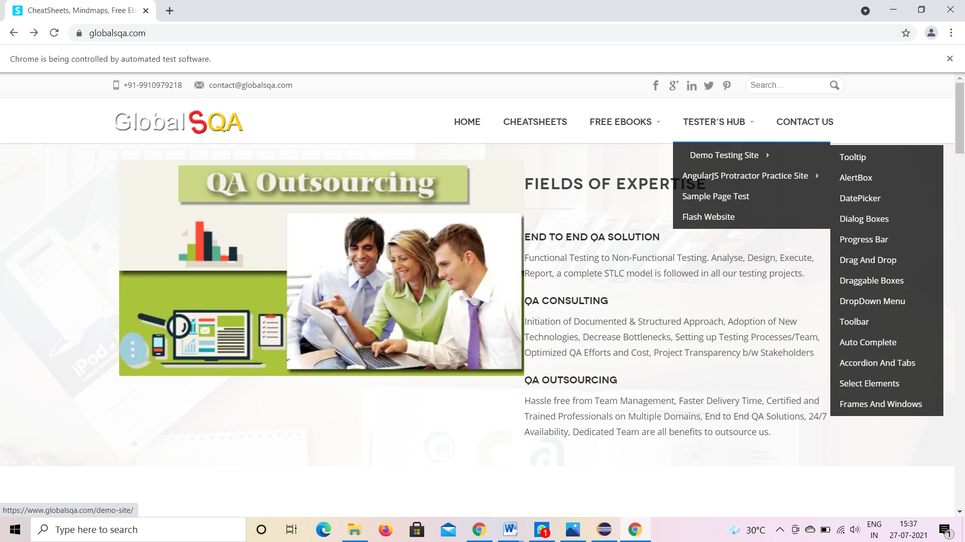

Slide 14
TC10: To verify the functionality of Tooltip
Selenium WebDriver Test Script:
WebElement DemoTesting = driver.findElement(By.xpath("/html/body/div/header/div[2]/div/div/div[3]/div/ul/li[4]/div/ul/li[1]/a/span"));
Actions builder1 = new Actions(driver);
builder1.moveToElement(DemoTesting).build().perform();
driver.findElement(By.xpath("/html/body/div/header/div[2]/div/div/div[3]/div/ul/li[4]/div/ul/li[1]/div/ul/li[1]/a/span")).click(); //click on tooltip
driver.findElement(By.id("Forms Based")).click();

Slide 15
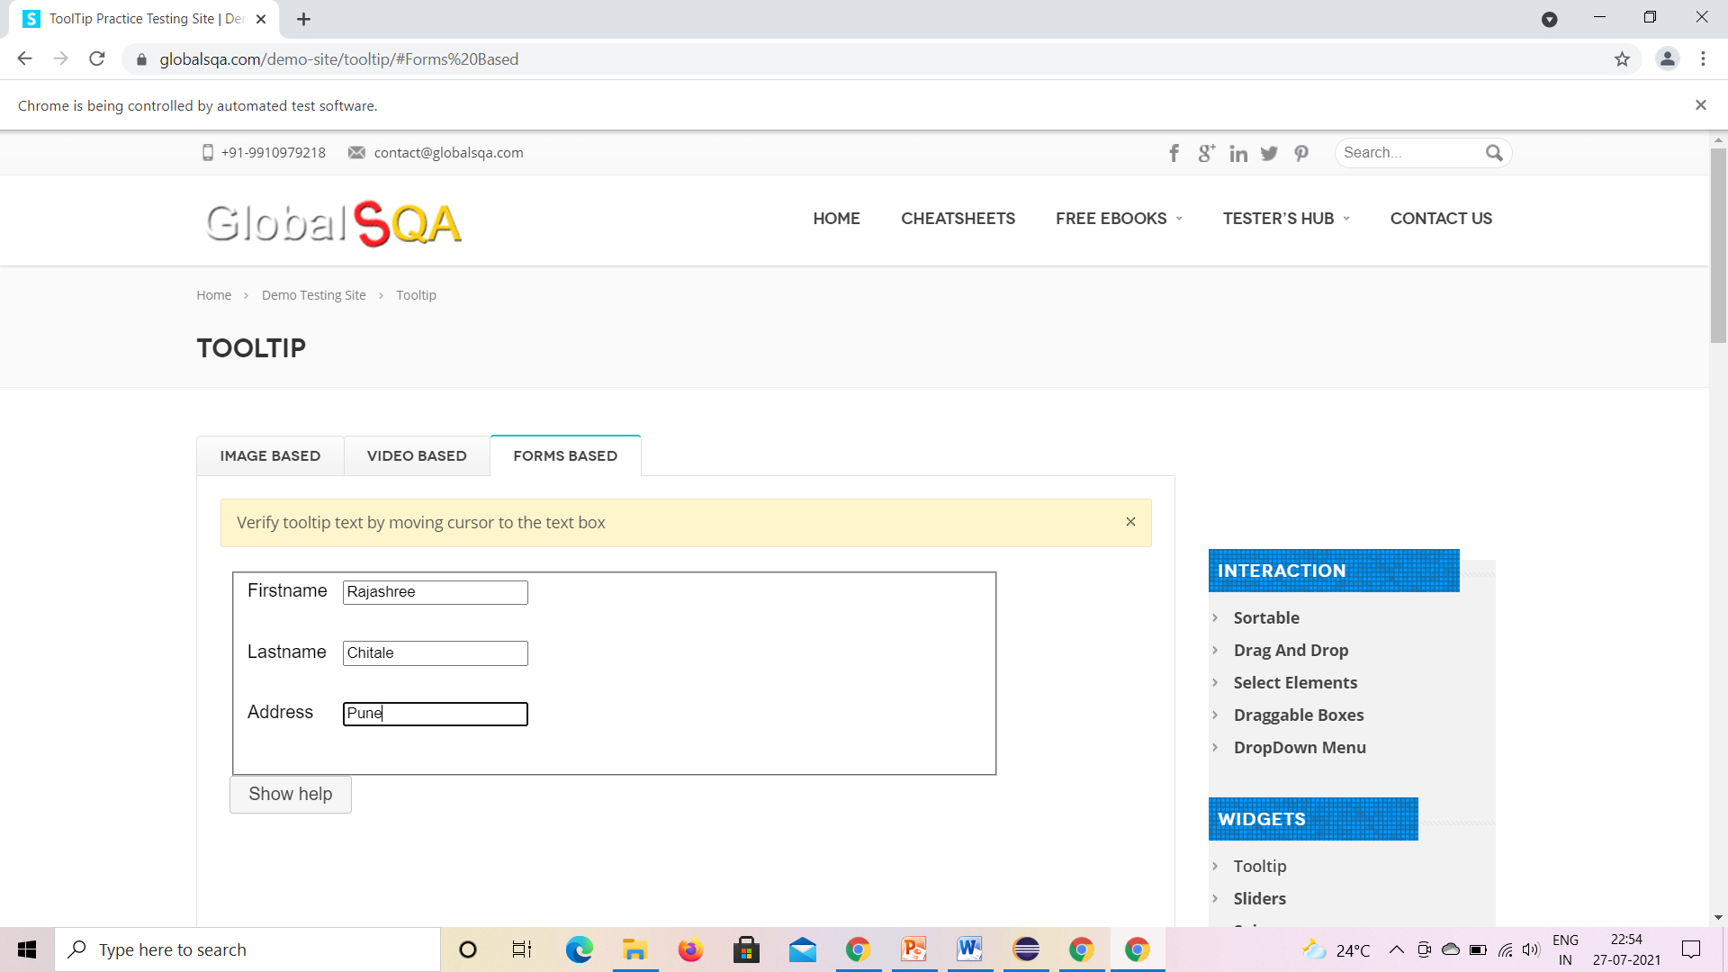

Slide 16
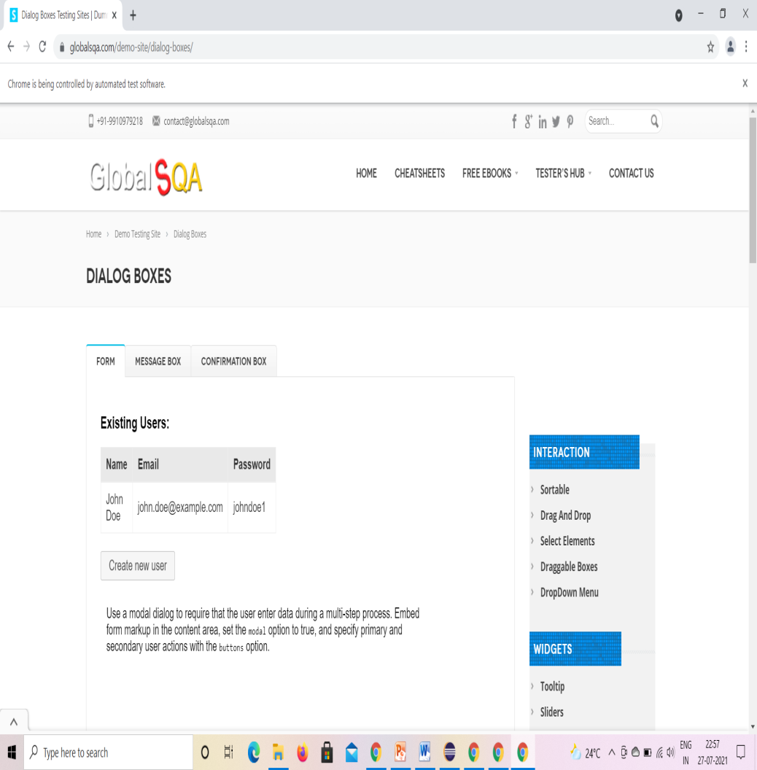
TC11: To verify Dialog Box Functionality.
Selenium WebDriver Test Script:
driver.findElement(By.xpath("/html/body/div/header/div[2]/div/div/div[3]/div/ul/li[4]/div/ul/li[1]/div/ul/li[4]/a/span")).click();

Slide 17
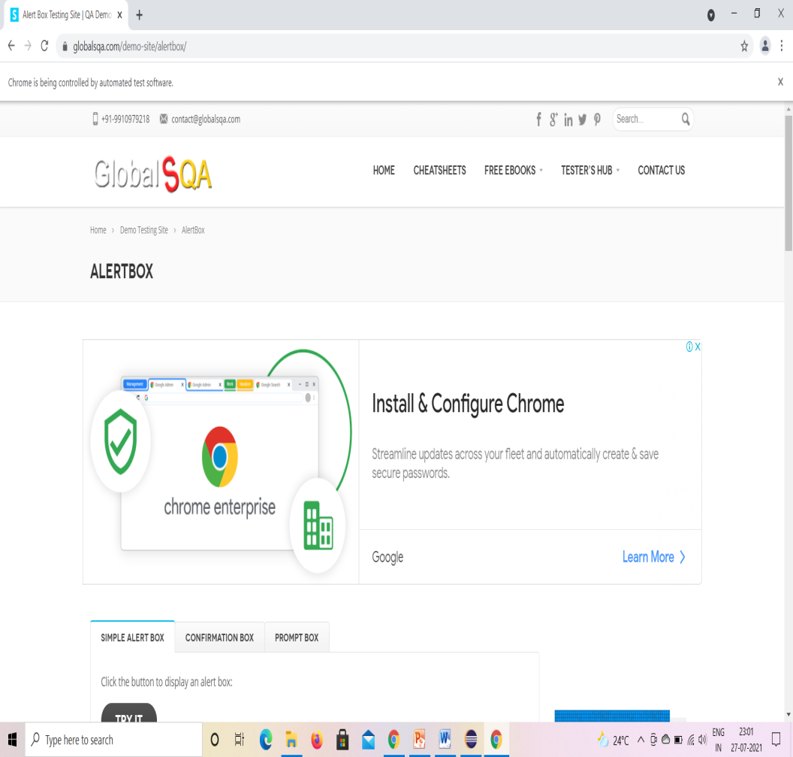
TC12: To verify the functionality of AlertBox.
Selenium WebDriver Test Script:
driver.findElement(By.xpath("/html/body/div/header/div[2]/div/div/div[3]/div/ul/li[4]/div/ul/li[1]/div/ul/li[2]/a/span")).click(); //click on alertbox

Slide 18
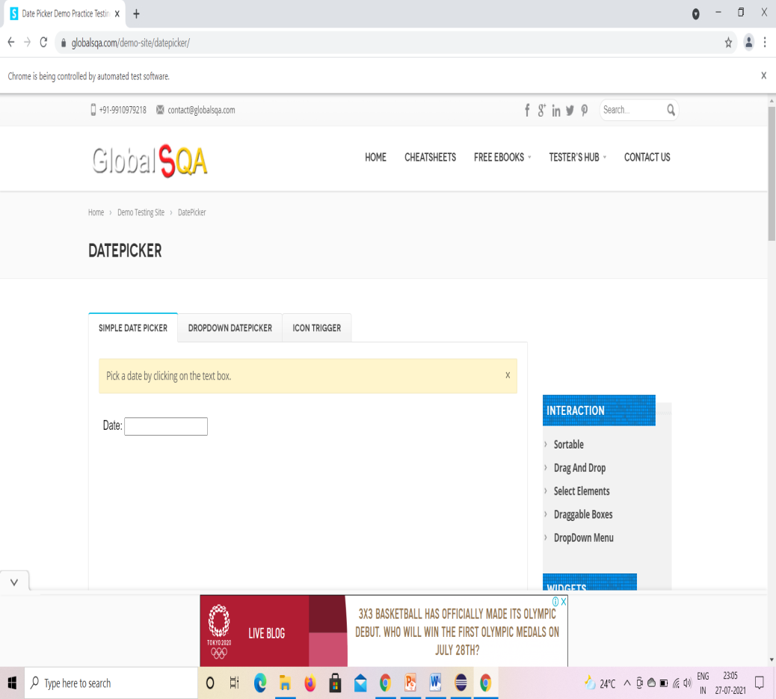
TC13: To verify the functionality of DatePicker.
Selenium WebDriver Test Script:
driver.findElement(By.xpath("/html/body/div/header/div[2]/div/div/div[3]/div/ul/li[4]/div/ul/li[1]/div/ul/li[3]/a/span")).click(); //click on alertbox
driver.findElement(By.id("Icon Trigger")).click();

Slide 19
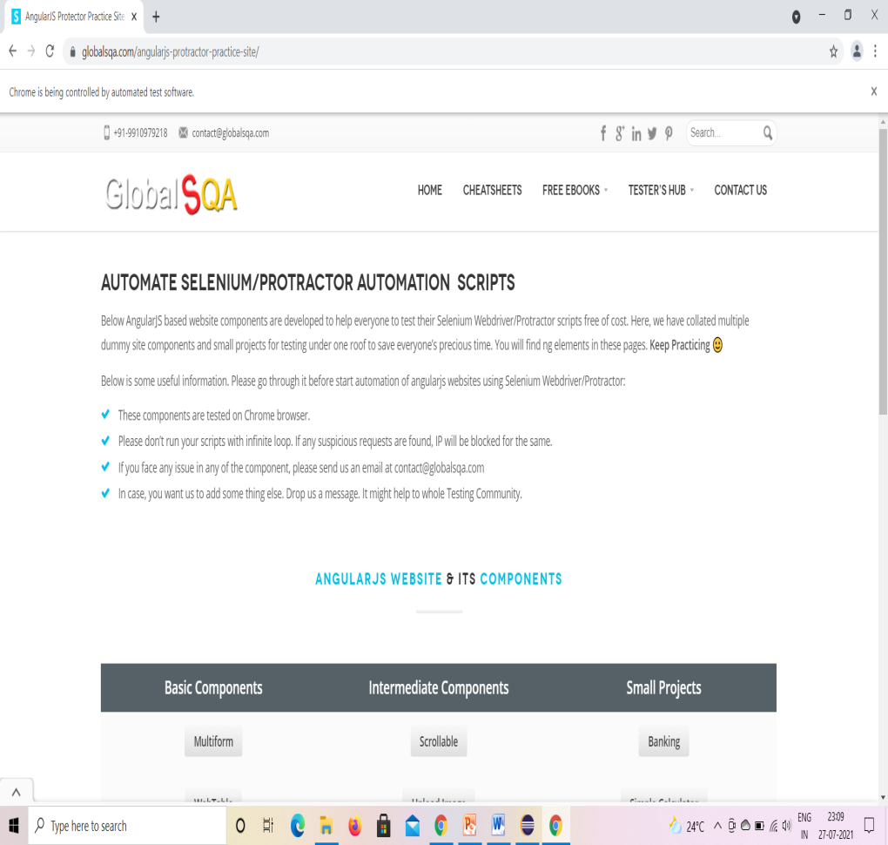
TC14: To verify the functionality of Angularjs Protect Practice Site.
Selenium WebDriver Test Script:
WebElementDemoTesting= driver.findElement(By.xpath("/html/body/div/header/div[2]/div/div/div[3]/div/ul/li[4]/div/ul/li[1]/a/span")); //mouse over angularjs
Actions builder1 = new Actions(driver);
builder1.moveToElement(DemoTesting).build().perform();
WebElementAngularjs= driver.findElement(By.xpath("//*[@id=\"menu-item-2822\"]/a"));
Actions Ajs= new Actions(driver);
builder.moveToElement(Angularjs).build().perform();

Slide 20
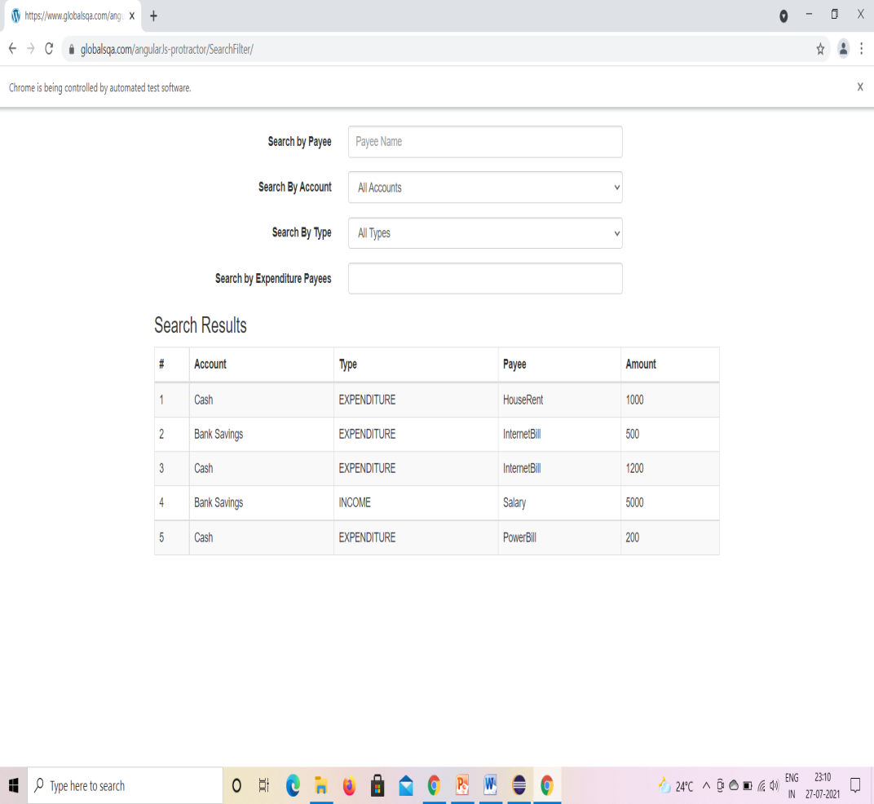
TC16: To verify the Functionality Of Filter.
Selenium WebDriver Test Script:
driver.findElement(By.xpath("/html/body/div/header/div[2]/div/div/div[3]/div/ul/li[4]/div/ul/li[2]/div/ul/li[1]/a/span")).click();

Slide 21
TC17: To verify The Functionality Of Scrollable.
Selenium WebDriver Test Script:
WebElementTesterHub= driver.findElement(By.xpath("//*[@id=\"menu-item-2822\"]/a")); //mouse over on testerhub
Actions builder = new Actions(driver);
builder.moveToElement(TesterHub).build().perform();
WebElementAngularjs= driver.findElement(By.xpath("/html/body/div/header/div[2]/div/div/div[3]/div/ul/li[4]/div/ul/li[2]/a/span")); //mouse over on Angularjs
Actions builder1 = new Actions(driver);
builder.moveToElement(Angularjs).build().perform();
driver.findElement(By.xpath("/html/body/div/header/div[2]/div/div/div[3]/div/ul/li[4]/div/ul/li[2]/div/ul/li[2]/a/span")).click();

Slide 22
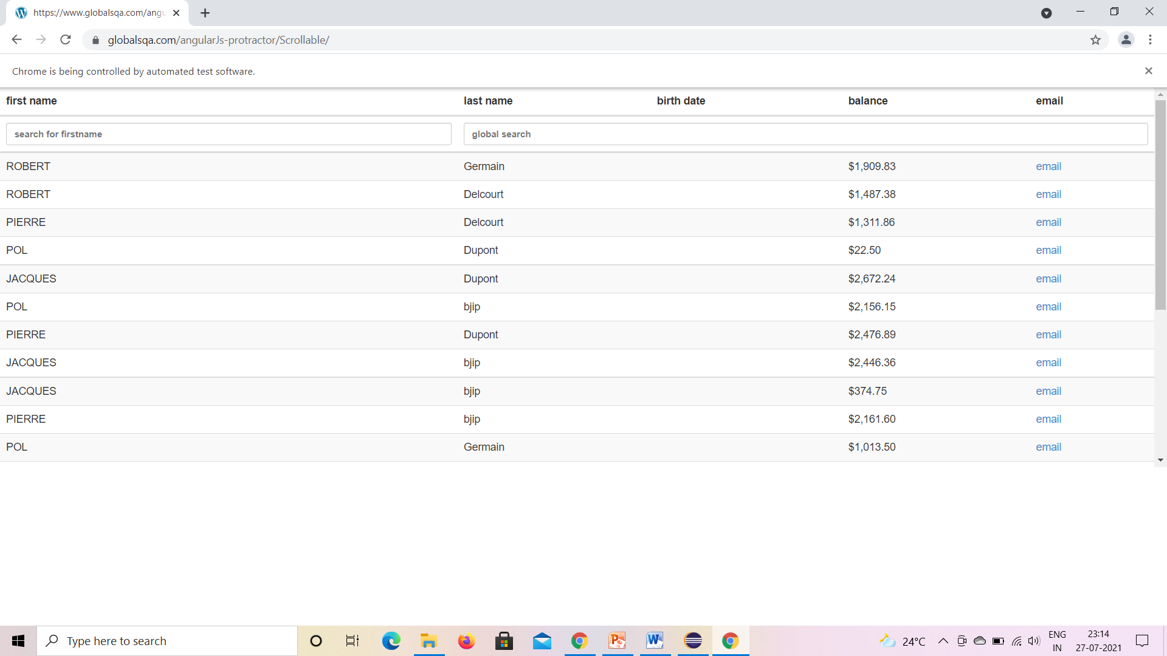

Slide 23
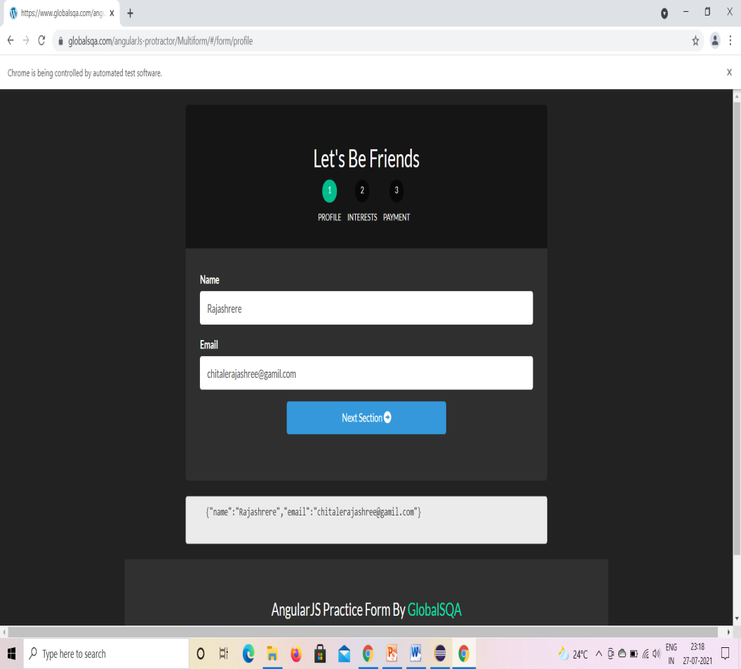
TC18: To verify and Functionality Of Multiform.
Selenium WebDriver Test Script:
driver.findElement(By.xpath("/html/body/div/header/div[2]/div/div/div[3]/div/ul/li[4]/div/ul/li[2]/div/ul/li[3]/a/span")).click();
driver.findElement(By.name("name")).sendKeys("Rajashree");
driver.findElement(By.name("email")).sendKeys("chitalerajashree@gmail.com");

Slide 24
TC19: To verify the navigation to go back to previous page.
Selenium WebDriver Test Script:
d.navigate().back();

Slide 25
TC20: To verify that browser is able to close.
Selenium WebDriver Test Script:
d.close();

Slide 26


